Slide 1
Final Project Title dfsdfs
Delivering an ML/AI Strategy, AI for Business Leaders, Udacity
Student Name, Month - Year

Slide 2
Executive Summary
Purpose of Project
Project origination -- e.g., taking the course itself
Need and/or impending doom of not running a data-driven business
Methodology
Analysis conducted over _________ weeks
Over ___ potential use cases underwent thorough assessment for feasibility and impact
Incorporated both technical knowledge and user feedback
Path Forward
___ use cases identified for implementation
Needs and requirements to be successful
Next steps

Slide 3
I began with five use case ideas
Use Case 1 Title
Description of Use Case 1 ------------------------------------------
Use Case 4 Title
Description of Use Case 4 ------------------------------------------
Use Case 2 Title
Description of Use Case 2 ------------------------------------------
Use Case 5 Title
Description of Use Case 5 ------------------------------------------
Use Case 3 Title
Description of Use Case 3 ------------------------------------------

Slide 4
I assessed feasibility vs. impact for all cases
UC 1
UC 3
Key criteria assessed
Key area 1
Key area 2
Key area 3
Key area 4
Key area 5
UC 7
UC 9
UC 10
UC 6
Impact
UC 5
UC 2
UC 8
UC 4
Feasibility

Slide 5
Transforming our business using ML/AI with these top two use cases
Use Case Title
Description of Use Case ------------------------------------------------------------------------------------
------------------------------------------------------------------------------------
------------------------------------------------------------------------------------
Use Case Title
Description of Use Case ------------------------------------------------------------------------------------
------------------------------------------------------------------------------------
------------------------------------------------------------------------------------
By executing on these two projects I believe we can drive ___________ for our business by _______ and become a(n) _______ business.

Slide 6
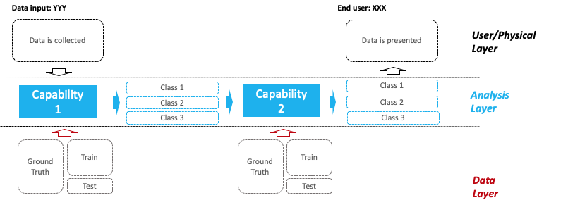
__________(Use case) Deep Dive
Process Today
Storyboard point 1
Storyboard point 2
Storyboard point 3
Storyboard point 4
Example Architecture
Process Tomorrow
Storyboard point 1
Storyboard point 2
Storyboard point 3
Storyboard point 4
The impact of ___ will be ____ thanks to ____!

Slide 7
__________(Use case) Deep Dive
Process Today
Storyboard point 1
Storyboard point 2
Storyboard point 3
Storyboard point 4
Example Architecture
Process Tomorrow
Storyboard point 1
Storyboard point 2
Storyboard point 3
Storyboard point 4
The impact of ___ will be ____ thanks to ____!

Slide 8
Risks/Mitigations
 | Use Case | Use Case
Accuracy Definition | Concerns: Plan: | Concerns: Plan:
Underfitting/Overfitting Definition | Concerns: Plan: | Concerns: Plan:
Ethical Concerns Definition | Concerns: Plan: | Concerns: Plan:

Slide 9
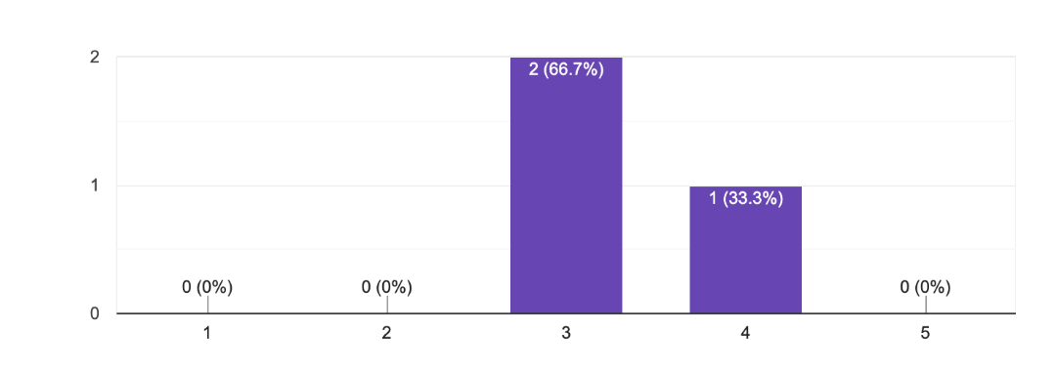
Feedback Thus Far
Illustrative Verbatim Quotes
Proposed Next Steps
Proposed next step 1
Proposed next step 2
Proposed next step 3
“Great job with x, y, z”
“___ Use case would fundamentally change our business because of ______”
Illustrative Visualization
Proposed Timeline
Month 1
Deliverable 1
Deliverable 2
Month 2
Deliverable 1
Deliverable 2
Month 3
Final Deliverable

